Slide 1


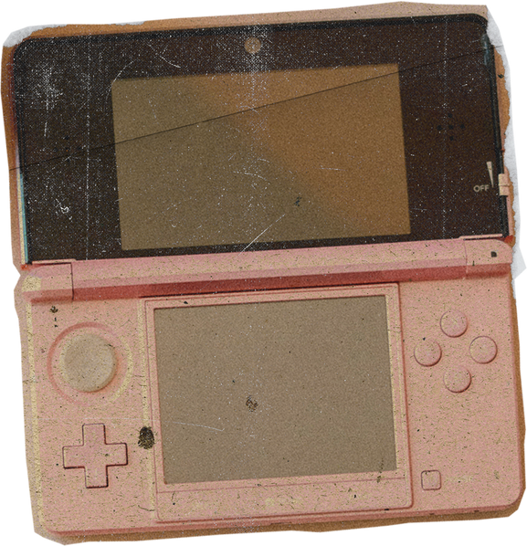



















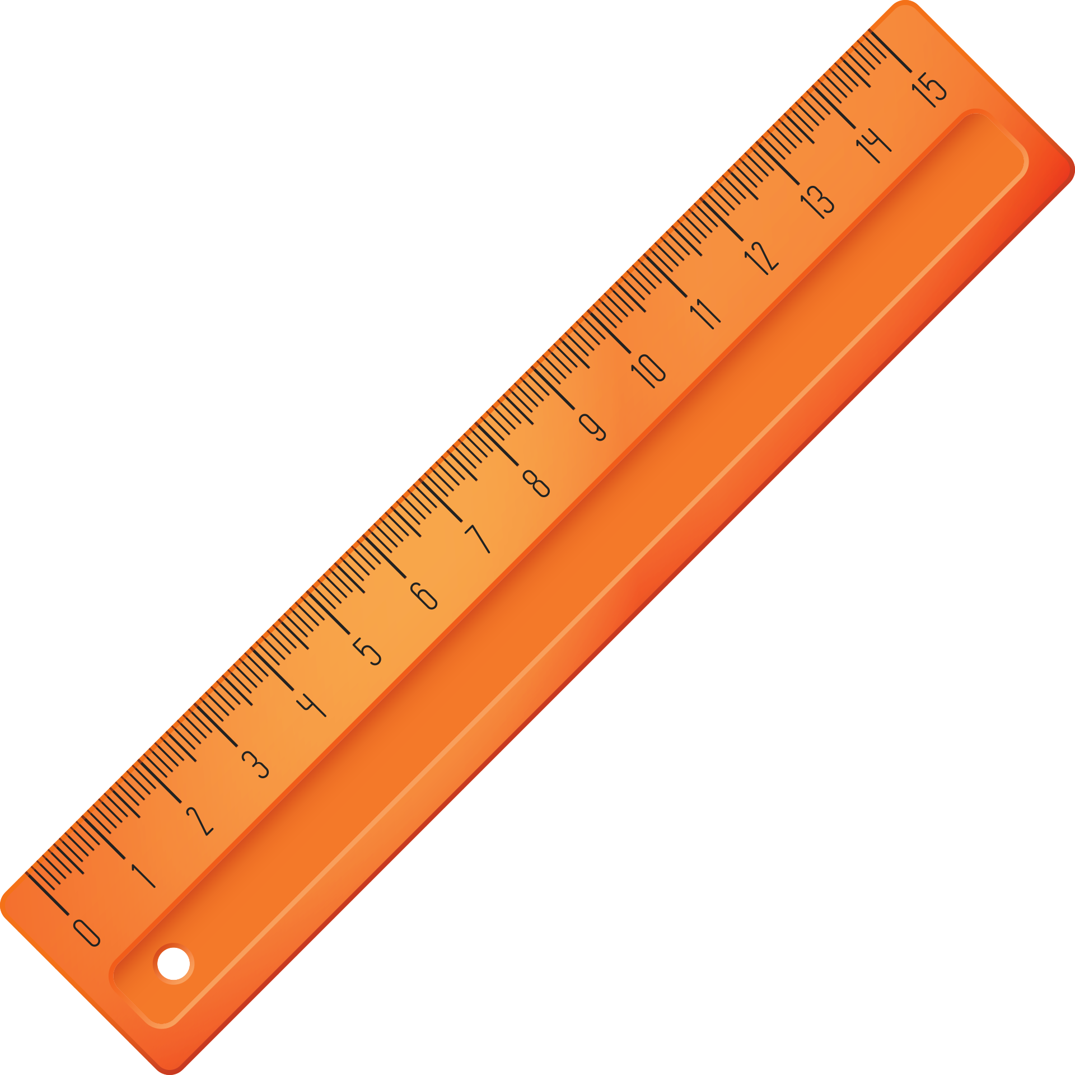

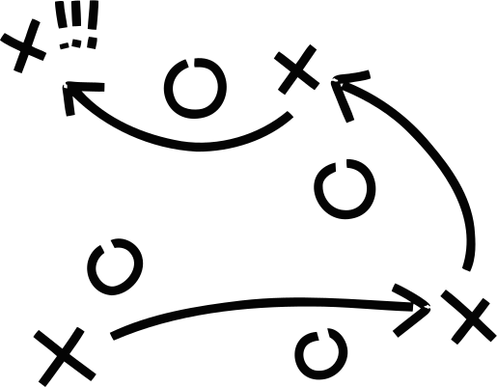

The Art of

Slide 2



Objective:
We will learn what time management is and strategize how we use our time to accomplish our goals.
M 5. Self-confidence in the ability to succeed.
B-LS 3. Time Management, organizational and study skills.
B-SMS-3. Perseverance to achieve long- and short-term goals.

Slide 3



  Helps understand our use of time
What is Time Management?
  Planning out our day/tasks
  Prioritizing what gets finished
  Working smarter, not harder!

Slide 4






Slide 5
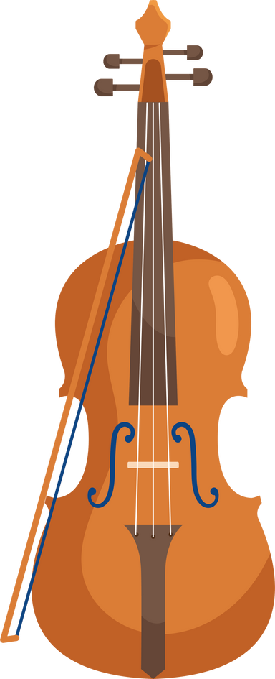






Why is Time Management Important?
  Helps us finish homework
  Reduces stress and worry
  Gives us more free time
  Makes us better students
  Helps us reach our goals
  Creates good habits

Slide 6






Finding the Time
  Stones in the Jar
Stones = Goals
Pebbles = Personal Tasks and Activities
Sand = Free time

Slide 7


  Do the hardest thing first
  Break big tasks into smaller parts (20/10 rule)
  Use a timer to stay on track
  Ask for help when needed
  Stay focused on your goal
  Evaluate your progress
Time Strategies
Notes:
Discusss how these strategies apply to Real-Life practice use these skills for:
• Homework assignments
• School projects
• Morning routines
• Chores at home
• Sports practice
• Study time

Slide 8




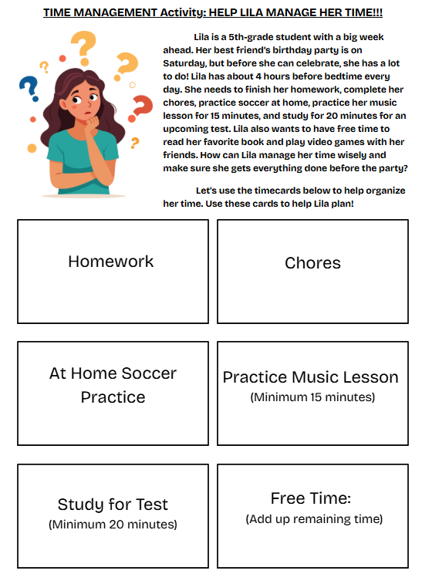
ACTIVITY: HELP LILA!!!
Team Success Tips:
  Listen to everyone's ideas
  Give each person a job
  Help teammates who need it
  Stay positive
  Keep track of time
  Celebrating improvements

Slide 9
Same Amount of Time

Slide 10


THE PROBLEM:
AVOID PROCRASTINATION
  START RIGHT AWAY, DON’T WAIT!
  SET A “MINI” DEADLINE
  REMOVE DISTRACTIONS
  TAKE SHORT BREAKS WHEN NEEDED
  KEEP YOUR WORKSPACE NEAT

Slide 11

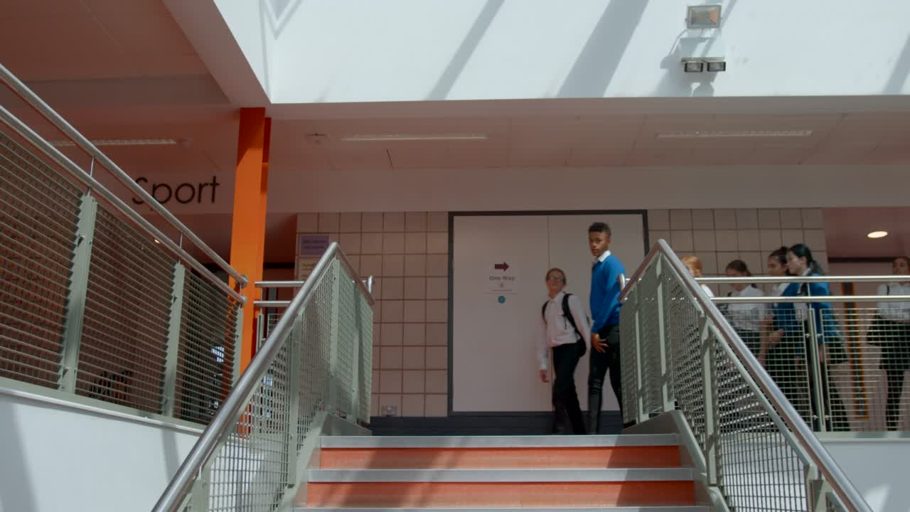
Things to Remeber about Time Management
  Practice makes perfect
  Use your new strategies every day
  Share tips with friends and family
  Keep track of your improvements
  Be proud of your progress!

